Slide 1
Hadoop Distributed File System

Slide 2
Outline
HDFS Architecture
File system Operations

Slide 3
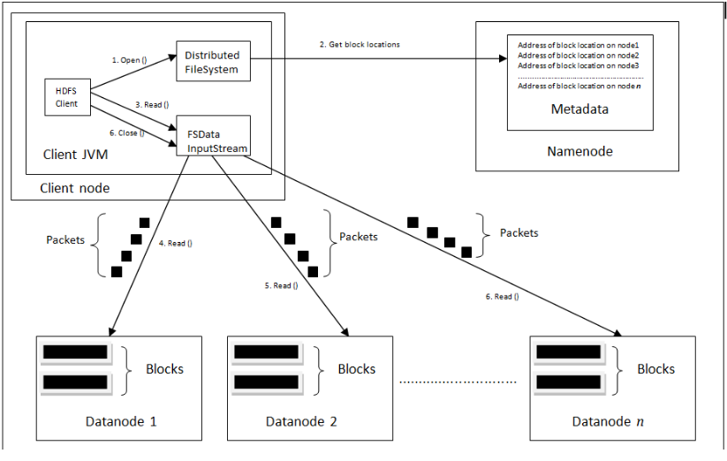
HDFS Architecture
Big data describes the large volume of data – both structured and unstructured that inundates a business on a day-to-day basis
Why Big data Matters?
It’s not the amount of data that’s important. It’s what organizations do with the data that matters.
Big data can be analyzed for insights that lead to better decisions and strategic business moves.

Slide 4
File System Operations
The following are the file systems in hadoop environment.
Local file system
Hadoop File system

Slide 5
File system commands..
Starting HDFS
Initially you have to format the configured HDFS file system, open namenode (HDFS server), and execute the following command.
$ hadoop namenode -format
After formatting the HDFS, start the distributed file system. The following command will start the namenode as well as the data nodes as cluster.
$ start-dfs.sh

Slide 6
File system commands..
Listing Files in HDFS
After loading the information in the server, we can find the list of files in a directory
$HADOOP_HOME/bin/hadoop fs -ls <args>

Slide 7
File system commands..
There are many more commands in "$HADOOP_HOME/bin/hadoop fs" than are demonstrated here. To get help the following will display a short usage summary for the operation in question, if you are stuck.
$HADOOP_HOME/bin/hadoop fs -help commandName
Inserting Data into HDFS
Create a file called file.txt in the local system which is ought to be saved in the HDFS file system. Follow the steps given below to insert the required file in the Hadoop file system.
Create an input directory.
$HADOOP_HOME/bin/hadoop fs -mkdir /user/input
Transfer and store a data file from local file system to the Hadoop file system using the put command.
$HADOOP_HOME/bin/hadoop fs -put /home/file.txt /user/input
List and verify the file using ls command.
$HADOOP_HOME/bin/hadoop fs -ls /user/input

Slide 8
File system commands..
Retrieving Data from HDFS
Assume we have a file in HDFS called input file. Given below is a simple demonstration for retrieving the required file from the Hadoop file system.
View the data from HDFS using cat command.
$HADOOP_HOME/bin/hadoop fs -cat /user/input/<filename>
Get the file from HDFS to the local file system using get command.
$HADOOP_HOME/bin/hadoop fs -get /user/input/ /home/hduser/

Slide 9
File system commands..
A table of all the operations is shown below. The following conventions are used for parameters:
"<path>" means any file or directory name.
"<path>..." means one or more file or directory names.
"<file>" means any filename.
"<src>" and "<dest>" are path names in a directed operation.
"<localSrc>" and "<localDest>" are paths as above, but on the local file system.
All other files and path names refer to the objects inside HDFS.

Slide 10
File system commands..
ls <path>
Lists the contents of the directory specified by path, showing the names, permissions, owner, size and modification date for each entry.
lsr <path>
Behaves like -ls, but recursively displays entries in all subdirectories of path.
du <path>
Shows disk usage, in bytes, for all the files which match path; filenames are reported with the full HDFS protocol prefix.

Slide 11
File system commands..
dus <path>
Like -du, but prints a summary of disk usage of all files/directories in the path.
mv <src> <dest>
Moves the file or directory indicated by src to dest, within HDFS.
cp <src> <dest>
Copies the file or directory identified by src to dest, within HDFS.

Slide 12
File system commands..
rm <path>
Removes the file or empty directory identified by path.
rmr <path>
Removes the file or directory identified by path. Recursively deletes any child entries (i.e., files or subdirectories of path).
put <localSrc> <dest>
Copies the file or directory from the local file system identified by localSrc to dest within the DFS.

Slide 13
File system commands..
copyFromLocal <localSrc> <dest>
Identical to -put
moveFromLocal <localSrc> <dest>
Copies the file or directory from the local file system identified by localSrc to dest within HDFS, and then deletes the local copy on success.
get [-crc] <src> <localDest>
Copies the file or directory in HDFS identified by src to the local file system path identified by localDest.

Slide 14
References
https://www.tutorialspoint.com/hadoop/hadoop_hdfs_operations.htm
https://hadoop.apache.org/docs/r2.4.1/hadoop-project-dist/hadoop-common/FileSystemShell.html

Slide 15
Questions
?

